Slide 1
Northwind Analysis
Carlie, Sara, Matthew, Ben

Slide 2
Key Insights
Summarize findings
Report actionable items
Recommendations

Slide 3
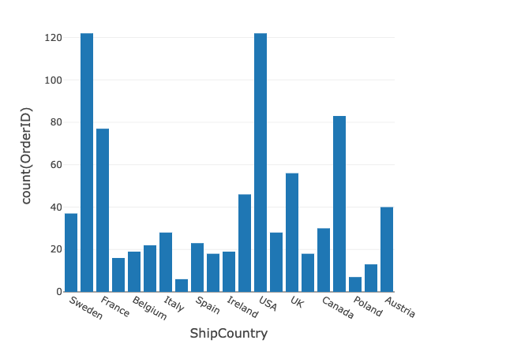
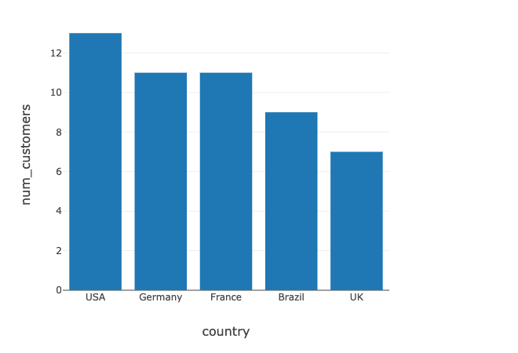
Where to Ship
Target Germany and USA
Italy is an underutilized market

Slide 4
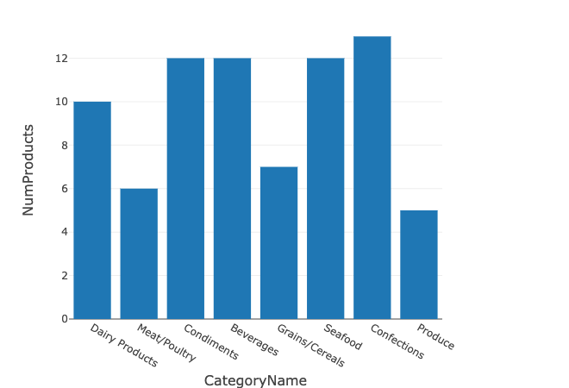
What Products
Invest in confections

Slide 5
Thank You

